Slide 1


Server-side scripts-PHP
Xbi 2021

Slide 2
Mål
Færdigheder
Udvikle med server-side scripts (PHP)

Slide 3
Setup PHP environment Local
Create a new Site in Local by flywheel
Create a PHP File
Location: Create a new PHP file (e.g., test.php) within your WordPress site's wp-content directory. You can choose a subdirectory if you prefer better organization.
Content: Add your PHP code to the file. Here's a simple example:
PHP
<?php echo "Hello from Local by Flywheel!"; phpinfo(); // Uncomment this line to see your PHP configuration ?>
2. Access the PHP File
Direct Access:
Open your web browser and navigate to the URL of your Local site, followed by the path to your PHP file:
http://[your-site-name].local/wp-content/test.php
You should see the output of your PHP code in the browser.

Slide 4
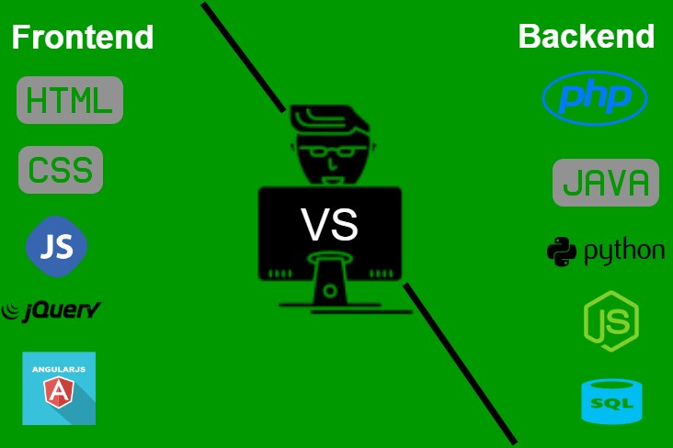
Frontend VS Backend
Notes:
https://www.geeksforgeeks.org/frontend-vs-backend/
Front End Frameworks and Libraries:
AngularJS: AngularJs is a JavaScript open-source front-end framework that is mainly used to develop single-page web applications(SPAs). It is a continuously growing and expanding framework which provides better ways for developing web applications. It changes the static HTML to dynamic HTML. It is an open-source project which can be free. It extends HTML attributes with Directives, and data is bound with HTML.
React.js: React is a declarative, efficient, and flexible JavaScript library for building user interfaces. ReactJS is an open-source, component-based front-end library responsible only for the view layer of the application. It is maintained by Facebook. Bootstrap: Bootstrap is a free and open-source tool collection for creating responsive websites and web applications. It is the most popular HTML, CSS, and JavaScript framework for developing responsive, mobile-first websites.
jQuery: jQuery is an open-source JavaScript library that simplifies the interactions between an HTML/CSS document, or more precisely the Document Object Model (DOM), and JavaScript. Elaborating the terms, jQuery simplifies HTML document traversing and manipulation, browser event handling, DOM animations, Ajax interactions, and cross-browser JavaScript development.
SASS: It is the most reliable, mature, and robust CSS extension language. It is used to extend the functionality of an existing CSS of a site including everything from variables, inheritance, and nesting with ease.
Back End Frameworks:
The list of back-end frameworks are: Express, Django, Rails, Laravel, Spring, etc.
The other back-end program/scripting languages are C#, Ruby, REST, GO, etc.

Slide 5
Sammenhængen
Client
Server
Html
CSS
JavaScript
PHP
SQL
Notes:
Eksempler først gang login

Slide 6
PHP
PHP er Serverstyret dvs. koden udføres/eksekveres på Serveren og sender/modtager In/Output til Clienten
PHP giver dig mulighed for at have login funktionalitet på din hjemmeside, køre et forum, samt mange andre interaktive og databasedrevne webapplikationer. .
Notes:
PHPTekstbaseret Serverprogrammer til webapplikationer Blandt andet Facebook og Wikipedia

Slide 7
Oprindelse af PHP
Rasmus Lerdorf - 1994 - Udviklet for at give ham mulighed for at spore besøgende til hans Internet side - PHP var oprindeligt et akronym for Personal Home Page, men senere blev det PHP: Hypertext Preprocessor
Notes:
https://en.wikipedia.org/wiki/Rasmus_Lerdorf

Slide 8

PHP og CMS
Notes:
Best PHP CMS in 2020
WordPress
Magento
Drupal
Joomla
OpenCart
ExpressionEngine
PyroCMS
OctoberCMS
Craft CMS
TYPO3
Contao
Neos CMS
ProcessWire
ButterCMS
Summarising up!
https://www.cloudways.com/blog/best-php-cms/

Slide 9
Oversigt over PHP
PHP er et script-sprog på serversiden, hvis scripts er indlejret i HTML-dokumenter
PHP er et alternativ til ASP.NET
PHP-processoren har to tilstande: kopiere (HTML) og fortolke (PHP)
Notes:
Husk gemme fil som *.php

Slide 10


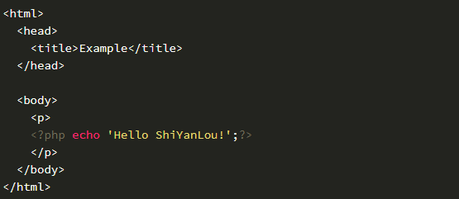
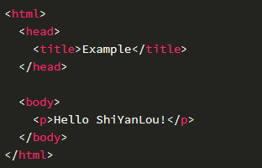
PHP- Server-side scripting
Notes:
kopiere (HTML) og fortolke (PHP)

Slide 11
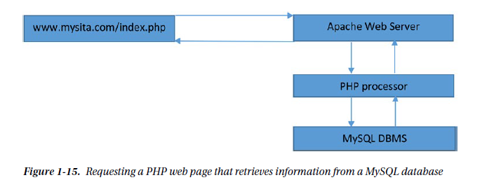
PHP Opsæting
MAMP/local

Slide 12
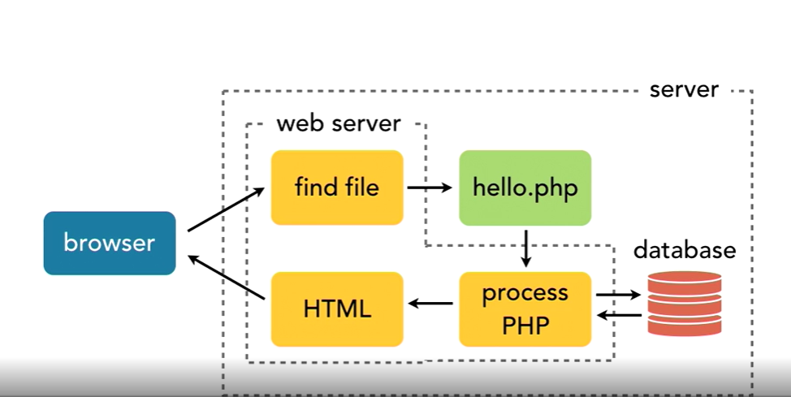
Notes:
demo
view-source:http://localhost:81/hello.php
What is a web server?
You machine can be a server?

Slide 13
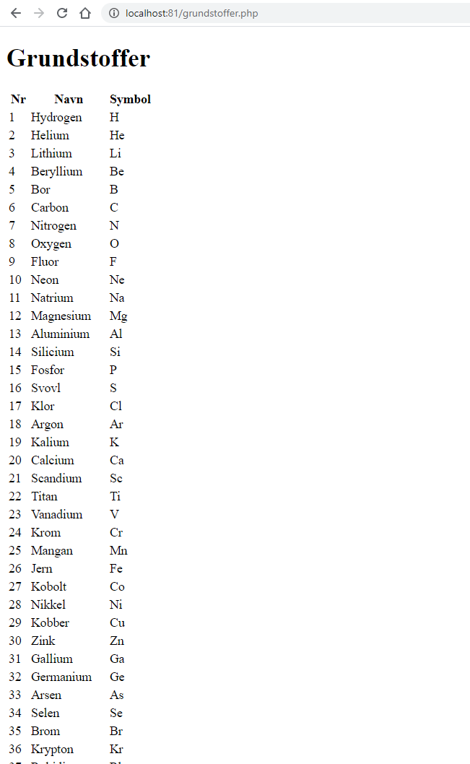
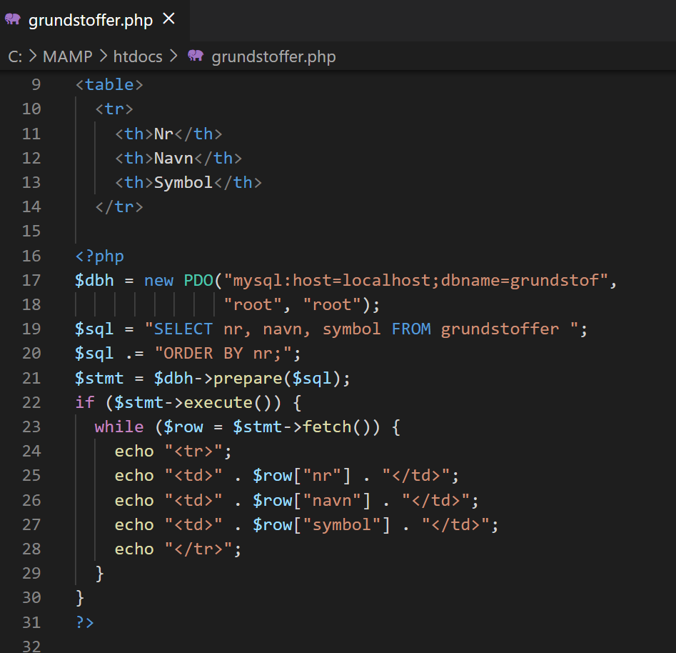
PHP (OOP) arbejde med database
Notes:
grundstoffer

Slide 14
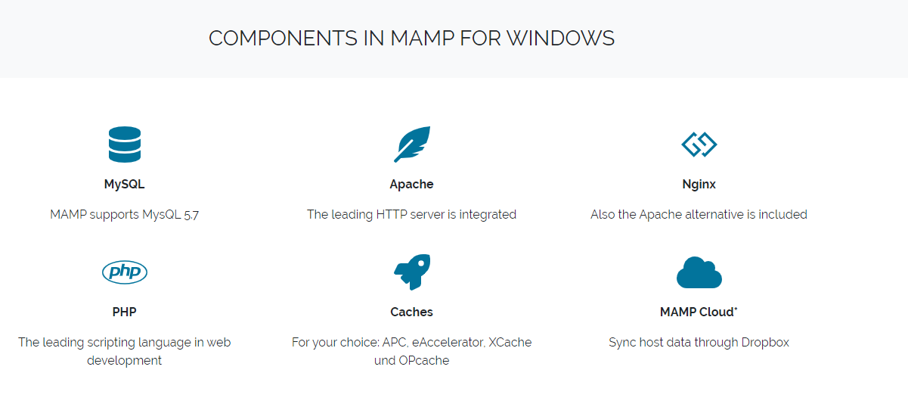
MAMP
Apache+PHP+MySQL
Notes:
https://www.mamp.info/en/mamp/windows/

Slide 15
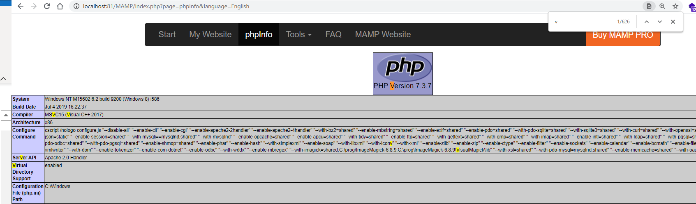
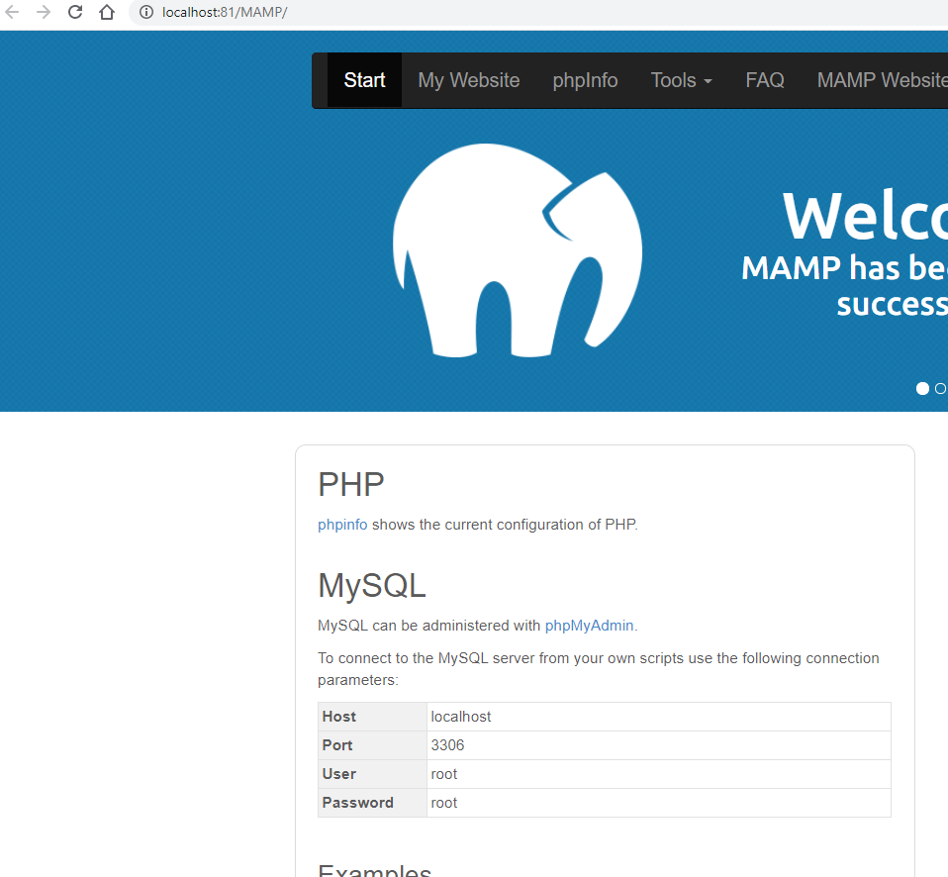
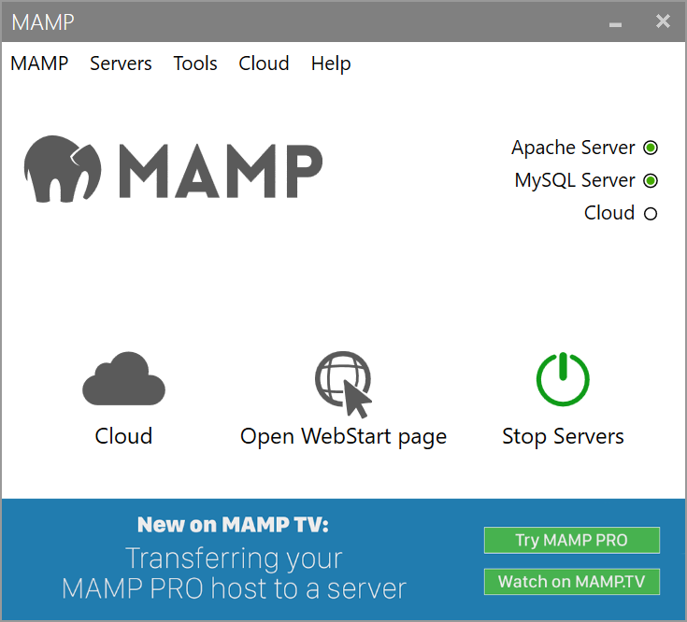
MAMP- Check PHP version
3
2
1

Slide 16
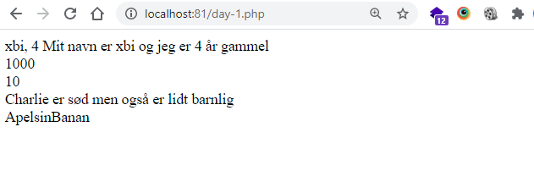
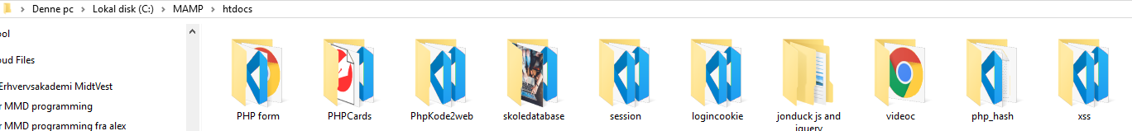
MAMP URL
url ：
format：http://host[:port][abs_path]
http:// HTTP protocal
host hvor er Internet host ip
port default 80
abs_path: fil navn (htdocs)

Slide 17
Øvelse
Kør MAMP
Og Prøv hello.php
https://www.w3schools.com/php/phptryit.asp?filename=tryphp_syntax

Slide 18
Pause

Slide 19
PHP-syntax
Nu skal du i gang med at programmere i PHP. PHP skrives inde i HTML-koden på denne måde:
<?php php-kodeteksten skrives her ?>
eller:
<?= php-kodeteksten skrives her ?>
Notes:
https://www.php.net/manual/en/language.basic-syntax.phptags.php

Slide 20
Echo ” ”;
Hvis du i PHP-koden vil skrive tekst til skærmen, foregår det med kommandoen:
echo "Teksten, der skal til skærmen";
Du skal skrive alle tekster (strenge) inde imellem " " (gåseøjne).
Efter hver 'statement' (slutning af sætningen), skrives et ';' (semikolon).

Slide 21
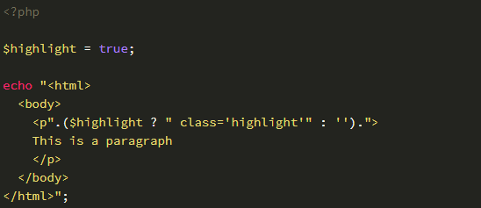
Echo html
Notes:
Echohtml.php

Slide 22
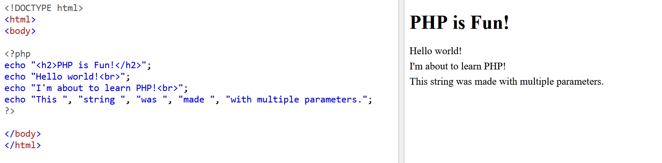
øvelse
Notes:
https://www.w3schools.com/php/phptryit.asp?filename=tryphp_echo1

Slide 23
kommentarer
kommentarer, som kun du kan se, er der flere metoder, der kan anvendes:
// dette er en kommentar til til én linie
# du kan også skrive kommentarer på denne måde
/* dette er lange kommentarer, der strækker sig over flere linier */

Slide 24
Variabler
Syntax'en for en PHP-variabel og værdi-tilskrivning er:
$variabelnavn = værdi;
Et variabelnavn indledes altid med '$', værdien tilskrives med et '=' og linien slutter altid med ';' (semikolon). Variabelnavnet kan starte med _ eller et bogstav, og kan godt indeholde tal, bare ikke som allerførste tegn. Der må ikke optræde mellemrum - er der flere ord, kan de evt. adskilles med _ ('underscore').
TIP: LOWERCAMELCASE
Ved navngivning af variable med lange navne kan du med fordel bruge den alment udbredte konvension, der kaldes 'lower camel case'. Her starter navnet med lille bogstav, men i de efterfølgende ord skrives det første bogstav med stort. Det betyder, at et variabelnavn som f.eks. '$total_med_moms' også kan skrives som:
'$totalMedMoms'
Det gør variabelnavnet mere læsbart og mere elegant. Denne konvension kan du genfinde i ord som iPhone.
https://www.phpartikler.dk/artikler/begynder1.php

Slide 25
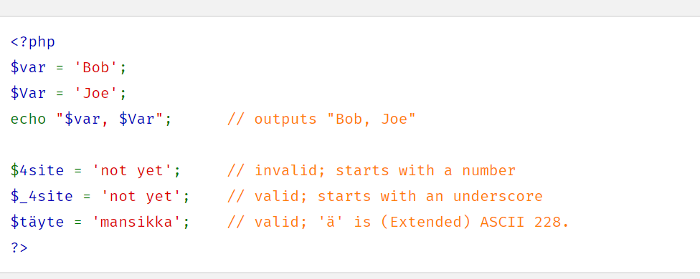
Variabler
Notes:
Variabelnavnet kan starte med _ eller et bogstav, og kan godt indeholde tal, bare ikke som allerførste tegn. Der må ikke optræde mellemrum - er der flere ord, kan de evt. adskilles med _ ('underscore')

Slide 26
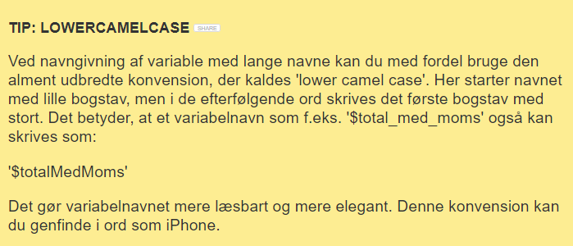
Variabler- navn

Slide 27

Erklæring værdi

Slide 28

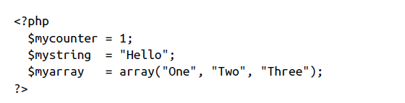
Variable assignment
Notes:
<?php // test1.php
$username = "Fred Smith";
echo $username;
echo "<br>";
$current_user = $username;
echo $current_user;
?>
Test i http://localhost/test1.php

Slide 29
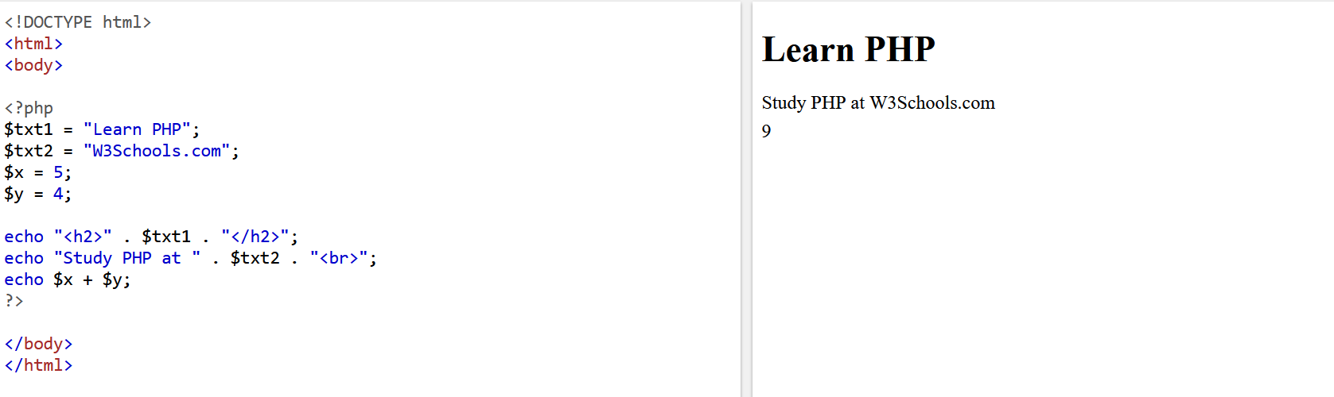
Øvelse
https://www.w3schools.com/php/phptryit.asp?filename=tryphp_echo2
https://www.w3schools.com/php/phptryit.asp?filename=tryphp_echo2
https://www.w3schools.com/php/phptryit.asp?filename=tryphp_echo2
Notes:
https://www.w3schools.com/php/phptryit.asp?filename=tryphp_echo2

Slide 30
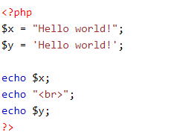



Data type
String
Integer
Float (floating point numbers - also called double)
Boolean
Array
Object
NULL
Notes:
PHP | var_dump() check type
https://www.geeksforgeeks.org/php-var_dump-function/#:~:text=The%20var_dump()%20function%20is,is%20also%20effective%20with%20expressions.
https://www.w3schools.com/php/php_datatypes.asp

Slide 31
Strenge sammenkædning
Operator “.” sammenkæder værdier
$msgs=5;
echo "You have " . $msgs . " messages.";
Notes:
Hvad er sammenkædning i JS?

Slide 32
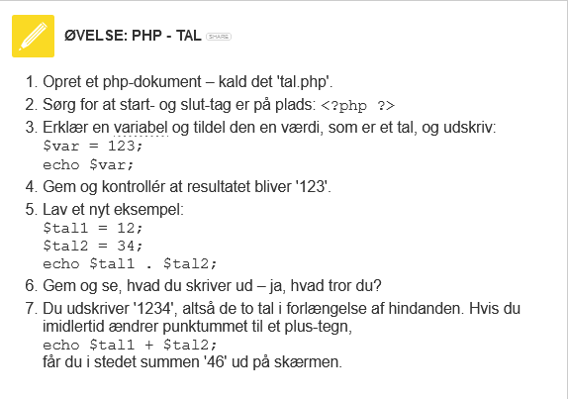
c759

Slide 33
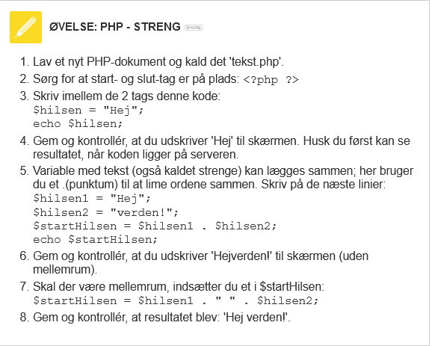
c756

Slide 34
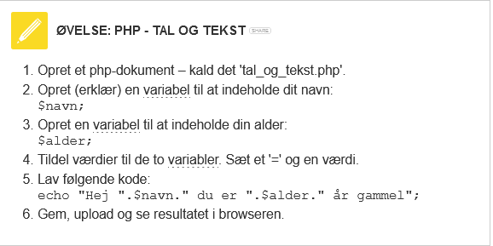
c761

Slide 35
Opsamling svar til de 3

Slide 36

Single eller double ”” eller ‘ ‘
” $variable ”
Se under Kode /singleDouble.php
Notes:
Virke ikke i single quote
singleDouble.php

Slide 37
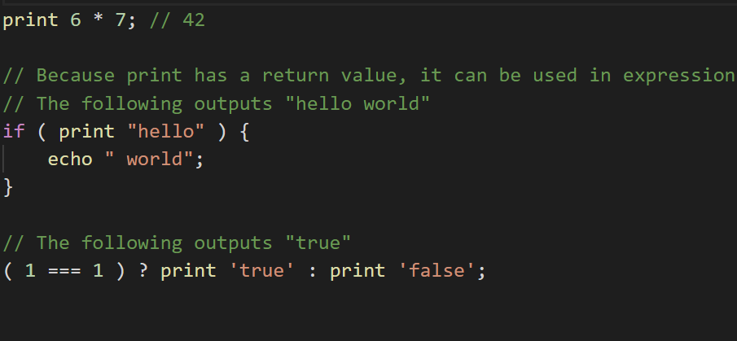
print eller echo

Slide 39
The print and echo are both language constructs to display strings. The echo has a void return type, whereas print has a return value of 1 so it can be used in expressions.
Notes:
https://www.tutorialspoint.com/what-is-the-difference-between-echo-print-and-print-r-in-php#:~:text=The%20print%20and%20echo%20are,readable%20information%20about%20a%20variable.

Slide 40
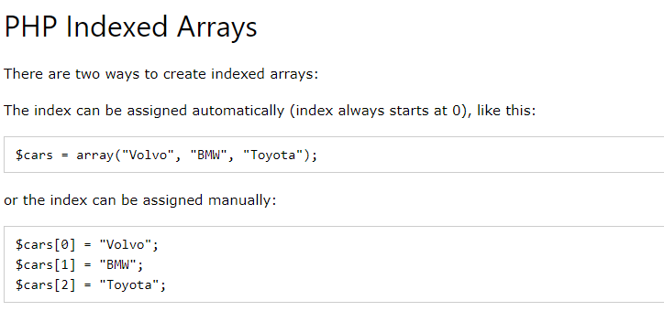
Eller print_r($cars)
Se array1.php
Notes:
https://www.w3schools.com/php/php_arrays_indexed.asp

Slide 41
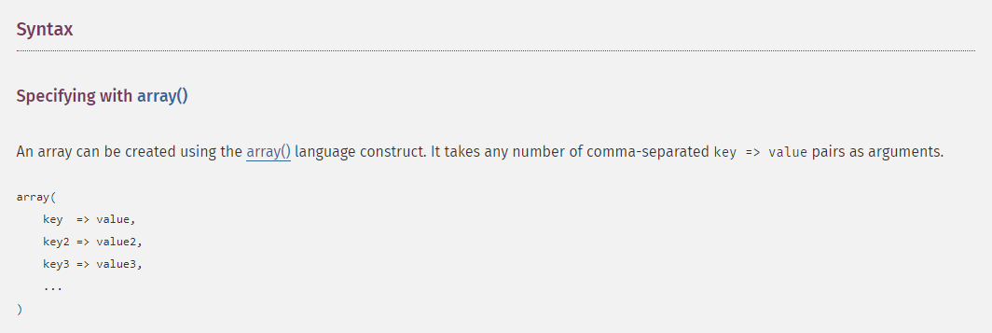
Notes:
PHP Manual

Slide 42
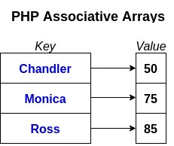
Associative Array
Notes:
Associativt array
https://www.w3schools.com/php/php_arrays_associative.asp

Slide 43
Exericse : A Php login page using session
Notes:
<?php
session_start();
// Example: Basic login with hardcoded credentials (for demonstration purposes only)
$username = "user";
$password = "password";
if (isset($_POST['submit'])) {
$enteredUsername = $_POST['username'];
$enteredPassword = $_POST['password'];
if ($enteredUsername === $username && $enteredPassword === $password) {
$_SESSION['logged_in'] = true;
header("Location: success.php"); // Redirect to success page
exit();
} else {
$error_message = "Invalid username or password.";
}
}
?>
<!DOCTYPE html>
<html>
<head>
<title>Login</title>
</head>
<body>
<h2>Login</h2>
<?php if (isset($error_message)) : ?>
<p style="color: red;"><?php echo $error_message; ?></p>
<?php endif; ?>
<form action="" method="post">
<label for="username">Username:</label>
<input type="text" name="username" id="username" required><br><br>
<label for="password">Password:</label>
<input type="password" name="password" id="password" required><br><br>
<button type="submit" name="submit">Login</button>
</form>
</body>
</html>

Slide 44
Create a Simple PHP Login System
Objective
Create a simple login system using PHP and CSS that includes a login page, a welcome page, and a logout functionality.
Requirements
Create the following PHP files:
login.php
welcome.php
logout.php
Create a CSS file:
styles.css
Specifications
1. login.php
Create a login form that includes fields for username and password.
Validate the login credentials against a hardcoded array of users (e.g., user1 with password1 and user2 with password2).
If the login is successful, redirect the user to welcome.php.
If the login fails, display an error message.
Key Components:
Use HTML forms (<form>).
Implement PHP session handling.
Style the form using CSS.
2. welcome.php
Display a welcome message that includes the username of the logged-in user.
Provide a link to log out (which will redirect to logout.php).
Key Components:
Implement session management to check if the user is logged in.
Style the welcome message using CSS.
3. logout.php
Destroy the session and redirect the user back to login.php.
Key Components:
Implement session destruction.
4. styles.css
Design the layout and style of the login and welcome pages.
Include styles for:
Body font and background
Container for the forms
Button styles
Error message styling
Deliverables
Submit the four PHP files and the CSS file.
Ensure that your code is well-organized and commented.
Bonus Challenge
Implement password hashing (using password_hash() and password_verify()) for better security.
Add a "Remember Me" checkbox to keep users logged in even after closing the browser.
Evaluation Criteria
Functionality: Does the login system work correctly?
Code quality: Is the code clean, well-structured, and commented?
Styling: Does the CSS enhance the user experience?
Creativity: Are there any extra features or improvements?

